Slide 1
Analysis of Movie Ratings
Himanshu Gupta

Slide 2
Dataset
IMDB Movie Dataset
Here are the links to the data source and location:
Data Source: MovieLens web site (filename: ml-20m.zip)
Location: https://grouplens.org/datasets/movielens/
Files used:
movies.csv
ratings.csv
tags.csv

Slide 3
Motivation
Everybody likes to watch movies but there are so many movies out there that it is not possible to watch every movie. So most people want to watch movies that are or going to be highly rated. Studying the performance of movies in the past based on their characteristics we can get some insights on how upcoming movies will be judged by the audience.
Not only the viewers but the people involved in production can also benefit from knowing about the reception of various types of movies.
This project aims to analyze the "movielens" dataset to look for common traits among highly rated movies. The project explores what kind of movies get high ratings and are also reviewed by a high number of individuals giving a measure of their popularity.

Slide 4
Research Question
Combining the data from the three files, for each movie we have the genres, tags associated with it, its average rating and the number of reviews over which the average was taken. Movies are characterized by their genres and tags while their performance is measured using the average ratings and number of reviews. A movie is considered to be "highly rated" if it has a high average rating over a large number of reviews.
The research question that this project aims to answer is that what are the characteristics(genres and tags) that are generally associated with highly rated movies. The goal is to use those genres and tags as filters to extract a select list of movies which has a much higher percentage of highly rated movies than the original list from the dataset.

Slide 5
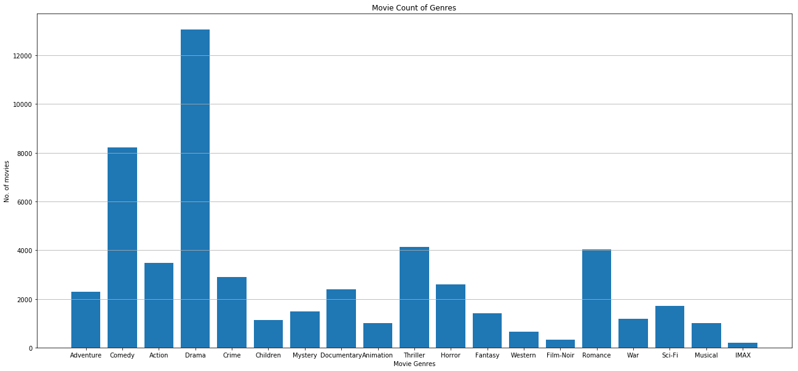
Findings

Slide 6
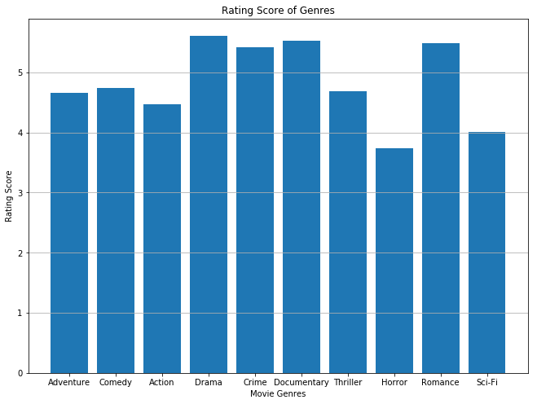
Findings
For fair evaluation only those genres with more than 1500 movies under them are considered.
The rating score for each genre is calculated by dividing the mean of ratings of all movies in the genre by their standard deviation(as a measure of consistency).
It can be seen from the histogram that there are 3 genres with higher scores but the "Drama" genre has much more number of movies(from previous slide). Thus the "Drama" genre is the best indiactor for movies with high average ratings.

Slide 7
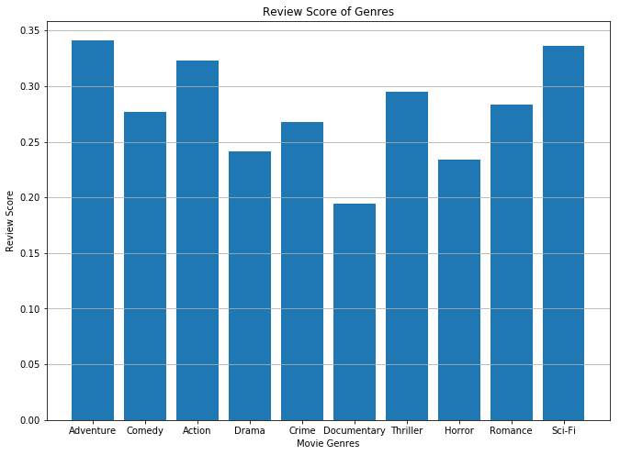
Findings
For fair evaluation only those genres with more than 1500 movies under them are considered.
The rating score for each genre is calculated by dividing the mean of number of reviews for all movies in the genre by their standard deviation(as a measure of consistency).
It can be seen from the histogram that the "Adventure" genre is the best indiactor for movies with high number of reviews.

Slide 8
Findings
A similar process was used to find the tags that were associated with highly rated movies. The following tags were chosen out of 137 popular tags:
High average ratings - "based on a true story, erlend's DVDs, great soundtrack, imdb top 250, overrated".
High number of reviews - "adventure, classic, based on a true story, erlend's DVDs, great soundtrack, imdb top 250, overrated, seen more than once".
Using the two filters for genres and the two above for tags, a mask was created to select the movies which had high average rating as well as more number of reviews.
The original dataset had a total of 27,278 movies out of which 48 movies had an average rating greater than 4.0 and over 20,000 reviews. The filtered list had only 1,786 movies(less by a factor of 15) and had all the 48 highest rated movies from the original list.

Slide 9
Acknowledgements
No informal analysis was used to inform my work.
I had no one give feedback for my work.

Slide 10
References
Most of the project work done on my own. I used the following blog for reference:
https://redroy44.github.io/2017/02/03/movielens/

